Slide 1
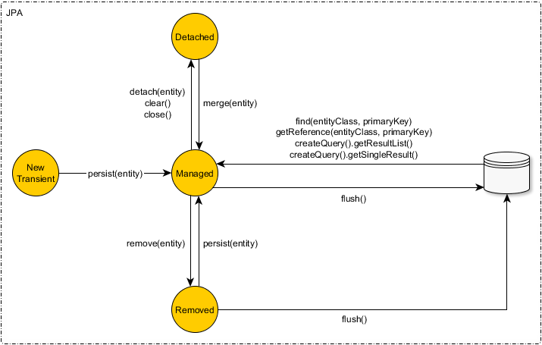
JPA state diagram
https://vladmihalcea.com/a-beginners-guide-to-jpa-hibernate-entity-state-transitions/

Slide 2
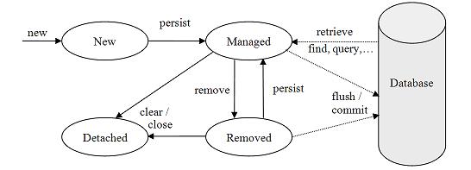
JPA state diagram

